Slide 1
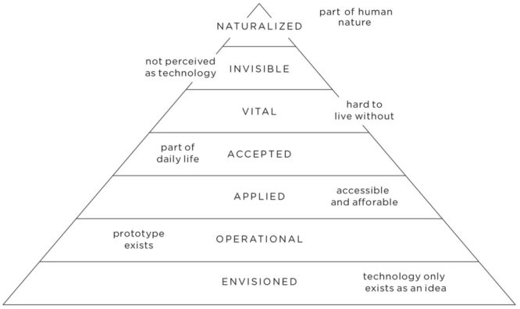
IMPACT OF TECHNOLOGY ONLINE COURSE COURSE ONE: ABOUT TECHNOLOGY
EXCERCISE: PYRAMID OF TECHNOLOGY
WWW.TICT.IO
EXPLANATION OF EXCERCISE
On the next page you see the pyramid of technology. In preparation to this excercise you have already read about the principals of the pyramid. In the excercise we ask you to come up with one or two technologies on each level. You can fill out the boxes on the next pages. Sometimes there is an arrow pointing to the direction the technologie is moving in the pyramid. You should take this into consideration.
The topic of the technologies is MUSIC.
This excercise works best if you do this with other people in a brainstorm.
Duration: 15 – 20 minutes

Slide 2
IMPACT OF TECHNOLOGY ONLINE COURSE COURSE ONE: ABOUT TECHNOLOGY
EXCERCISE: PYRAMID OF TECHNOLOGY
WWW.TICT.IO
Please fill out the
gray boxes!
MUSIC

