Slide 1
A FREE ONLINE TOOLKIT THAT HELPS PEOPLE (INVENTORS, DESIGNERS, USERS, DECISION MAKERS) TO MAKE BETTER, DELIBERATE DECISIONS ON THE IMPACT OF TECHNOLOGY.
WWW.TICT.IO
Notes:
Introduction
This is a FREELY USABLE presentation about the tecnhnology impact toolkit by Fontys University. This presentation is regularly updated. This is version 2.0 – november 2020.
WHY – HOW – WHAT This presentation is – rather predictable – structured by asking the questions why – how – what. First we will outline WHY a technology impact toolkit is so important, next we will explain what we have created, how it works and how we did it! In the final slides you will be invited to participate.

Slide 2
Notes:
This tool is designed as a very fun and specific way to make you think about the impact of technology.
But why is that so important?

Slide 3
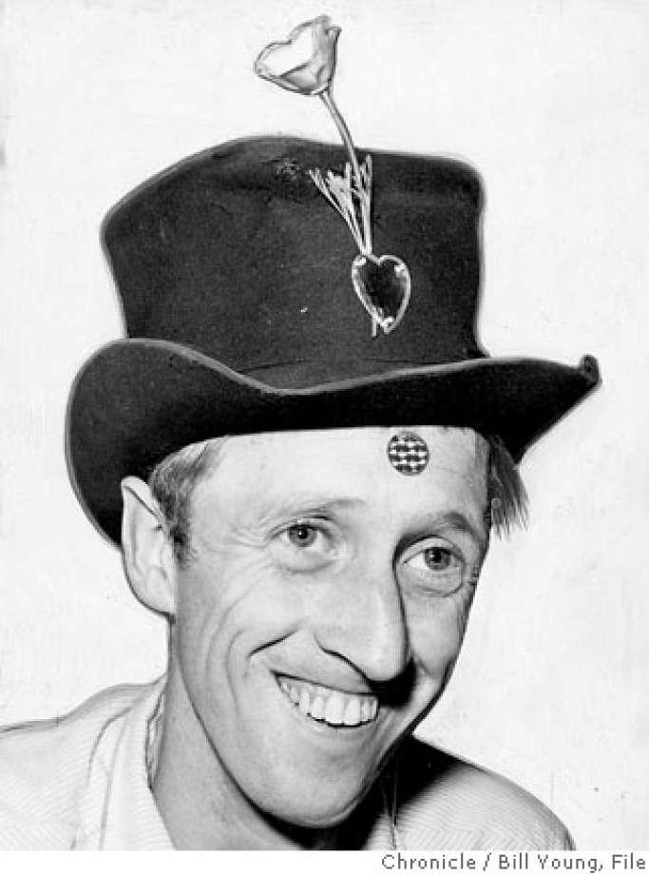
FOTO CHRONICLE - BILL YOUNG
Notes:
WHY?
Let’s start with this guy!
His name is Stewart Brand, a true Silicon Valley inspiration. He once stated that if you want to change people, you have to change the instruments they work with. Do it, and you will change people, and that way change society. This means that programming, designing, inventing or creating technology in a way is programming, designing, inventing of creating people. It is something you really have to think about. You really have to learn to think about. The TICT is going to help you with that.
The next slide shows our most important instruments from the past 30 years and how they changed us. It is a kind of a magnification, but it makes a point.

Slide 4
Notes:
At Fontys University we are challenging our students more and more to solve real problems using technology. We have ICT – students doing this, but also students from Healthcare, Marketing Management, Engineering, Real Estate, Logistics and so on. There are also a lot of minors and masters in which we challenge the students to solve a problem using technology. Fontys University wants to make an impact on society, technology is often the way to do it, and that means it will help if we learn & help our students to really think about technology. That is why we have created a FREE ONLINE technology impact tool.
Also we have non-technical students that need to understand the impact of technology to grow. As professionals (for example journalist asking questions or managers making decisions) but also as human beings.

Slide 5
Notes:
WHY – SUMMARY

Slide 6
Notes:
WHAT?
The Technology Impact Cycle Tool offers:
A quick scan with the most important questions of the 10 categories – you can print a canvas;
A full scan with (approx.) 50 questions to help you really think about the impact – you can print a impact document;
An improvement scan to find out how to improve a technology – you can print a canvas;
Ten inspiring crash courses of one hour;
Offline versions of the quick and improvement scan (for download)

Slide 7
Notes:
HOW does it work? What are design principles?

Slide 8
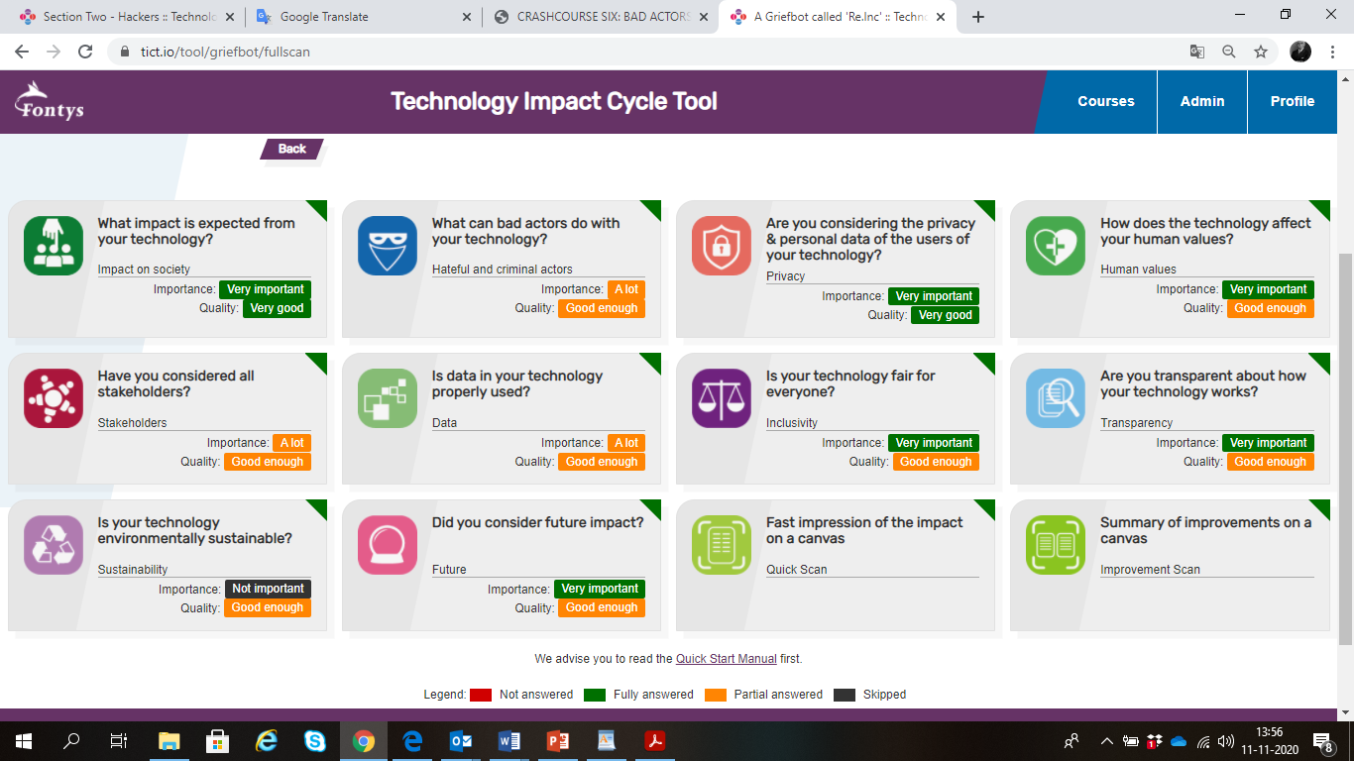
FULL SCAN
Questions in 10 categories
Non-normative questions
Track your progress & quality
Print a impact document
Supportive questions and material
Notes:
THE FULL SCAN:
Questions in ten categories;
Non normative questions;
It is up to you which questions you want to answer and which you want to skip;
The tool tracks the progress;
You can rate the importance and quality of the answers;
You can print an impact document;
The categories offer all kind of links to further reading, videos and other frameworks.

Slide 9
Notes:
Example questions from the full scan

Slide 10
QUICK SCAN
Ten most important questions
Offline version & help
Printable Canvas
Notes:
Quick Scan:
One question per category;
Questions are part of full scan (no separate trajectories);
Offline version available with help side (for in the classroom);
Printable canvas.

Slide 11
IMPROVE-MENT
SCAN
Ten questions
Offline version & help
Printable Canvas
Notes:
Improvement Scan:
One question per category;
Questions are part of full scan (no separate trajectories);
Offline version available with help side (for in the classroom);
Printable canvas.
For gaining insight in what are the most important things to improve.

Slide 12
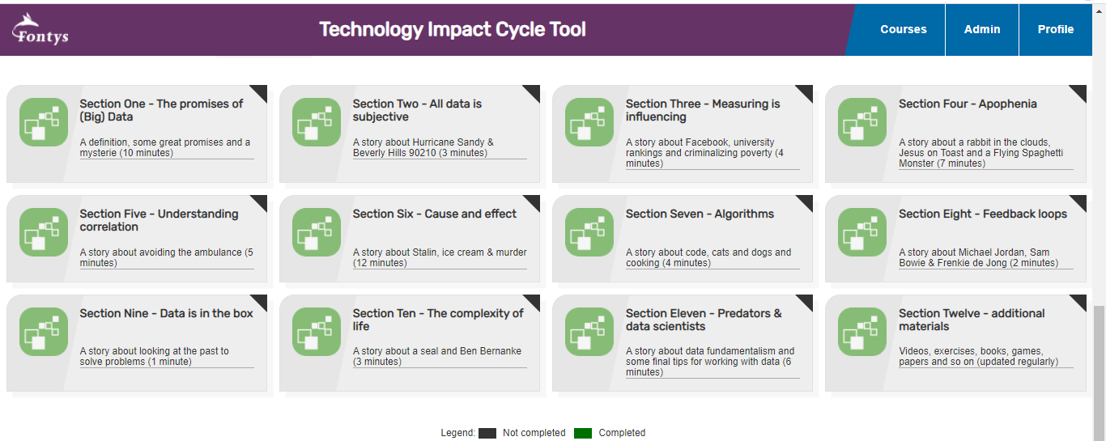
CRASH COURSES
Fun, inspiring, curiosity!
Certificates and a shirt
Ten courses of one hour
Track progress
Lots of additional materials
Notes:
Crash courses:
Ten free, online crash courses of one hour;
Different short sections;
No beginner or advanced, but fun & inspiring
Track progress;
Certificates and a shirt (maybe)
Lots of additional material

Slide 13
BEST PRACTICES
Different succesful approaches
For different kind of users
One hour to six months
Offline and online
Notes:
BEST PRACTICES
We used the TICT a lot. We collected the best practices and wrote them down. Using different perspectives (designer, teacher, critic) we provide you with tips & tricks to use the tool. But eventually it is up to you.

Slide 14
ALL SCANS ANSWERED
A CRY ANALYZER APP
EXAMPLE CASES
A GRIEFBOT
CORONA TRACING APP
Notes:
EXAMPLE CASES
Everywhere In the tool there are GRIEFBOT – examples. We described a GRIEFBOT – technology and answered all the questions. A Griefbot is of course a technology that is highly debatable which makes it perfect as an example for our tool.

Slide 15
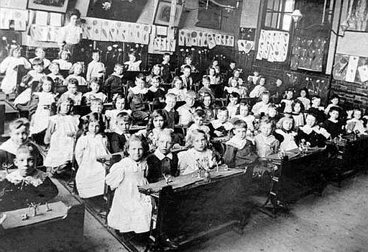
Notes:
COMMUNITY
We are working with a research – group of 10+ researchers. Some are professor, some are teacher, some are student, some are IT-people. Together we do research by building a toolkit and testing that version with (large) groups of students. The tool consists of 10 categories. Every category has an ambassador that works on making the question betters. As a group we try to create a better product.
Finally we are also testing the tool with three companies to get extra input.
So let’s look at the tool…

Slide 16
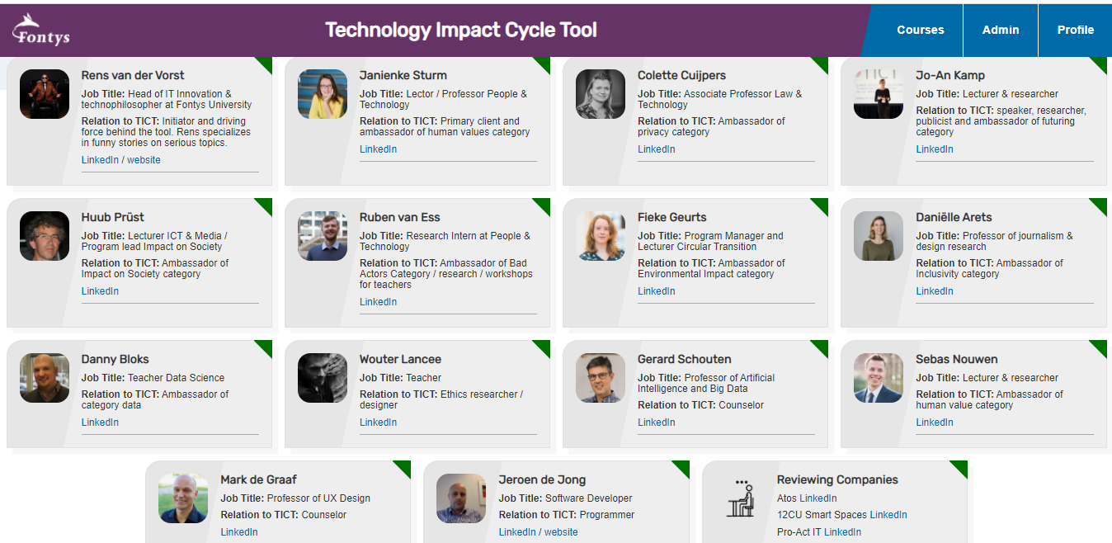
JOIN US!
COMMU-NITY
INFO@TICT.IO
Notes:
COMMUNITY – JOIN US!

Slide 17
WANT TO KNOW MORE / JOIN / PARTICIPATE / A WORKSHOP:
INFO@TICT.IO
WWW.TICT.IO

