Slide 1
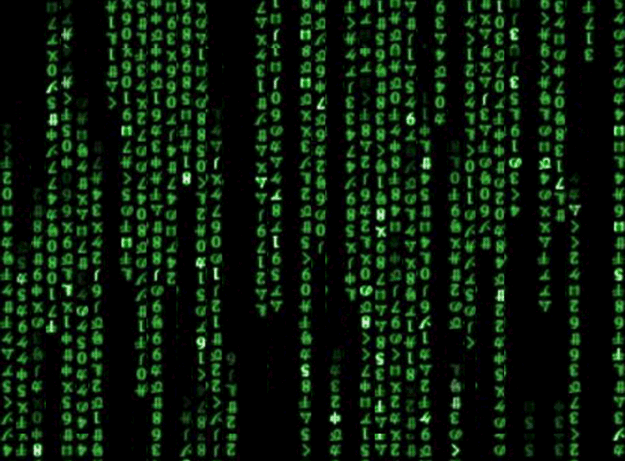
GENERAL INTRODUCTION:
WWW.TICT.IO IS AN ONLINE FREE TOOL TO HELP DEFINE THE IMPACT OF TECHNOLOGY. BY ASKING
QUESTIONS, YOU THINK ABOUT THE ANSWERS AND
GAIN NEW INSIGHTS ON POSSIBLE IMPROVEMENTS
OF YOUR TECHNOLOGY.
WWW.TICT.IO OFFERS A VARIETY OF OTHER SOURCES
AND FRAMEWORKS AND TEN INSPIRESTING CRASH-
COURSES OF ONE HOUR THAT HELP YOU REALLY
THINK ABOUT THE IMPACT OF TECHNOLOGY IN A FUN WAY.
THIS PRESENTATION ACCOMPANIES CRASHCOURSE
FOUR (DATA). IF YOU WANT YOUR PROGRESS TRACKED OF RECEIVE A
CERTIFICATE, PLEASE MAKE AN ACCOUNT ON
WWW.TICT.IO
QUESTIONS: INFO@TICT.IO
https://www.linkedin.com/in/rensvandervorst/

Slide 2
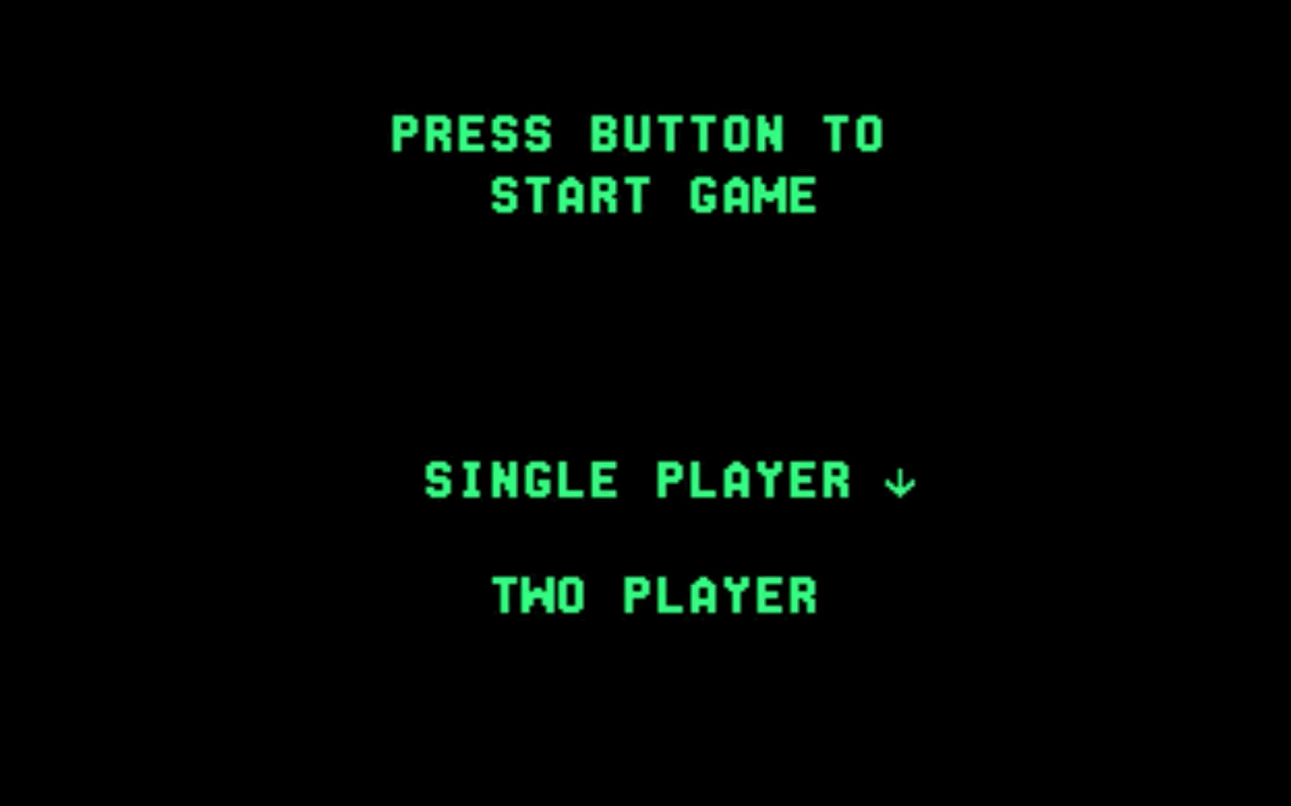
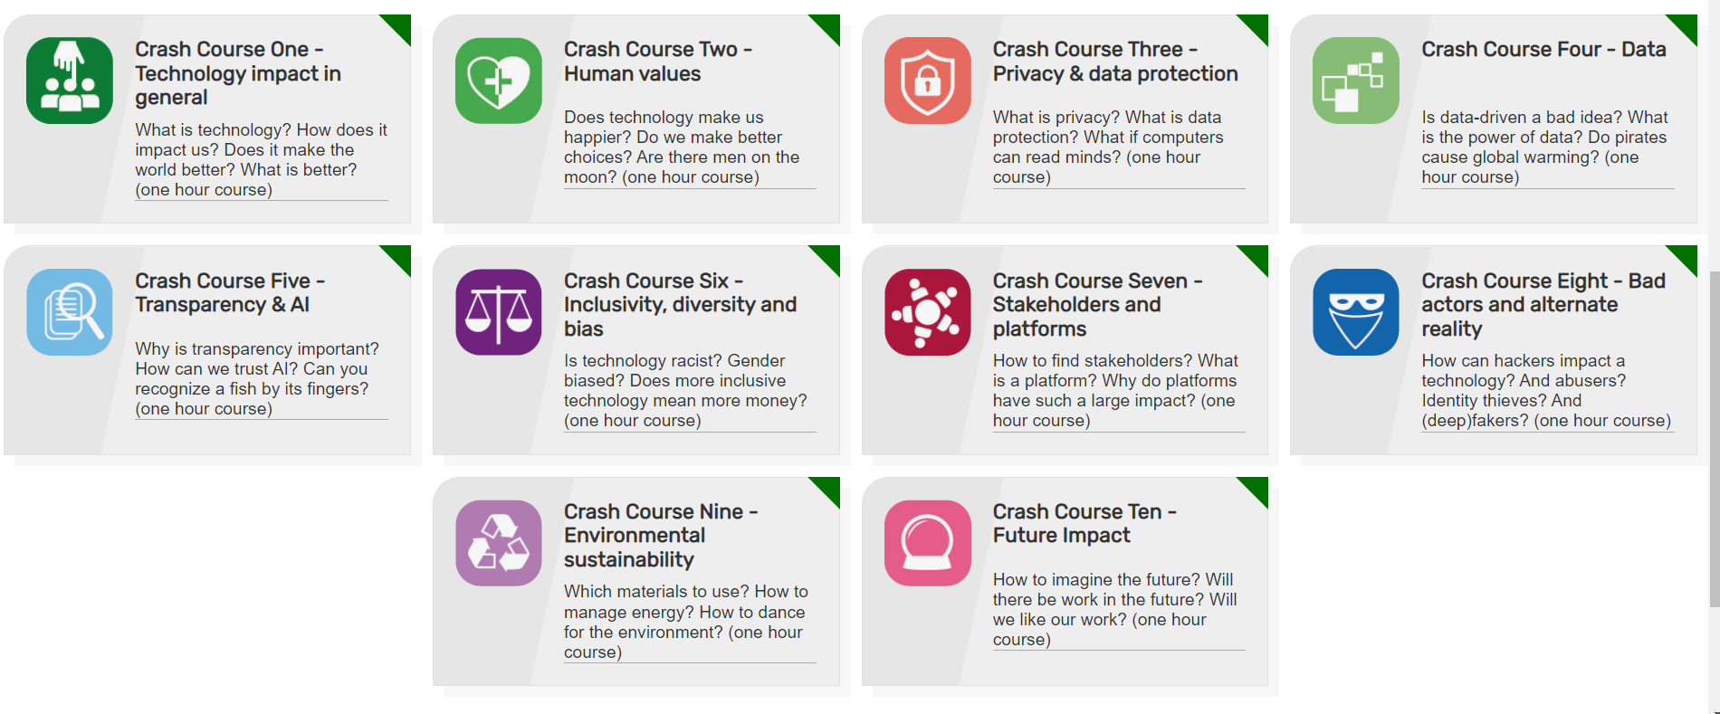
TICT.IO

Slide 3
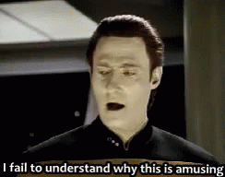

Slide 4
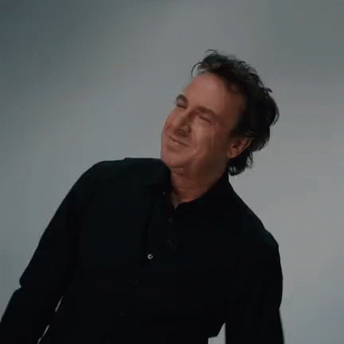
RESULTS FROM THE PAST ARE TRULY A GAURANTEE FOR THE FUTURE

Slide 7
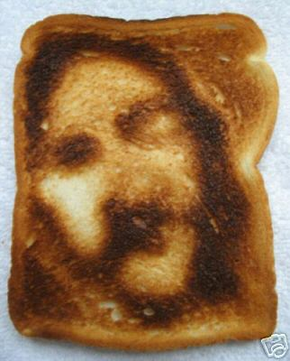
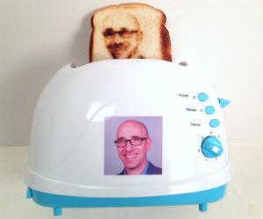

Slide 12
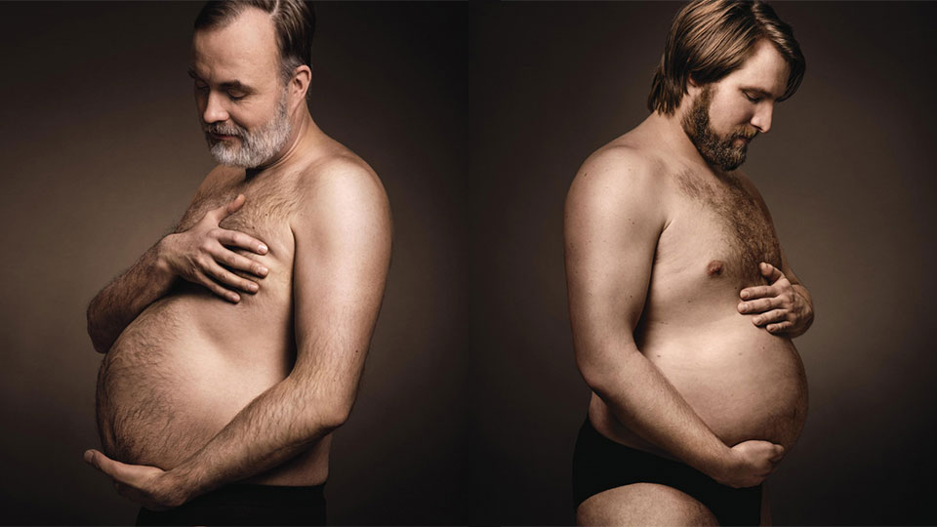

Slide 15
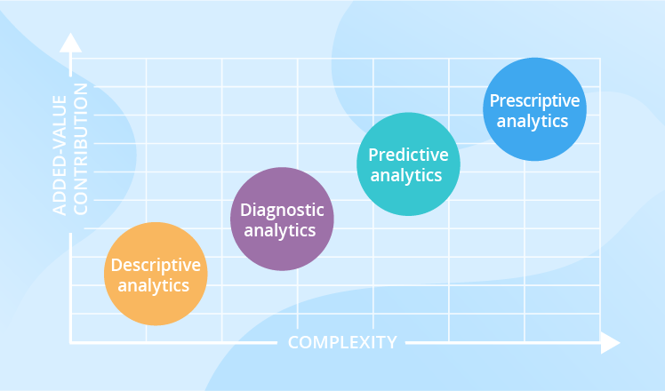

Slide 17
ARTSEN MAKEN (PERCENTUEEL!) VEEL MEER ONGELUKKEN MET EIGEN PRIVÉ-VLIEGTUIGEN
ALS HET HARDER GAAT WAAIEN IN DUITSLAND, WORDT ER DAAR MEER YOGHURT VERKOCHT
DE ACHTERNAAM VAN 66% VAN DE SUCCESVOLLE MANNEN BEGINT MET EEN LETTER UIT 1E HELFT VAN HET ALFABET
MENSEN DIE VEEL VENKEL KOPEN MAKEN MINDER GEBRUIK VAN HUN INBOEDEL-VERZEKERING

Slide 18
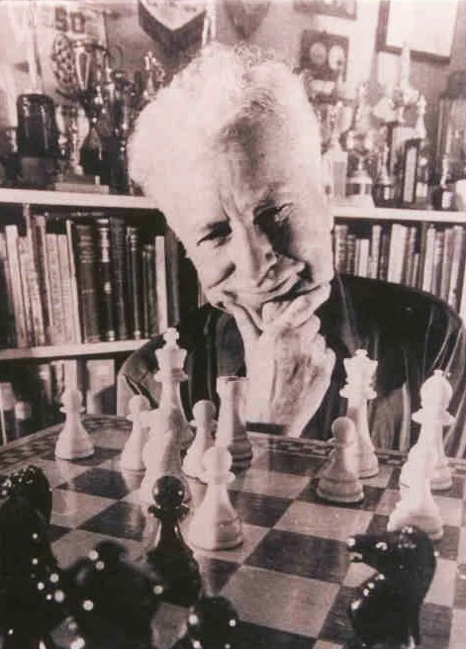
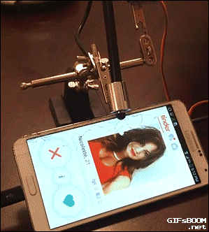
WOULD DIE FOR YOU….
ELO SCORE

Slide 19
PLEASE NEVER USE THE WORD DATADRIVEN AGAIN…

Slide 20
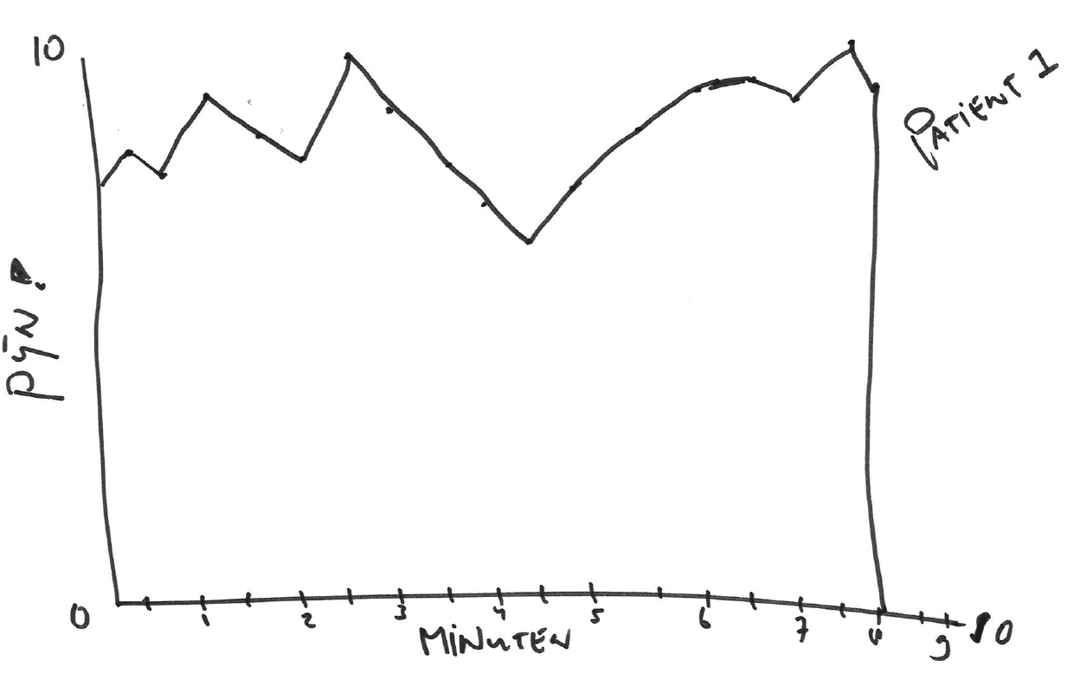
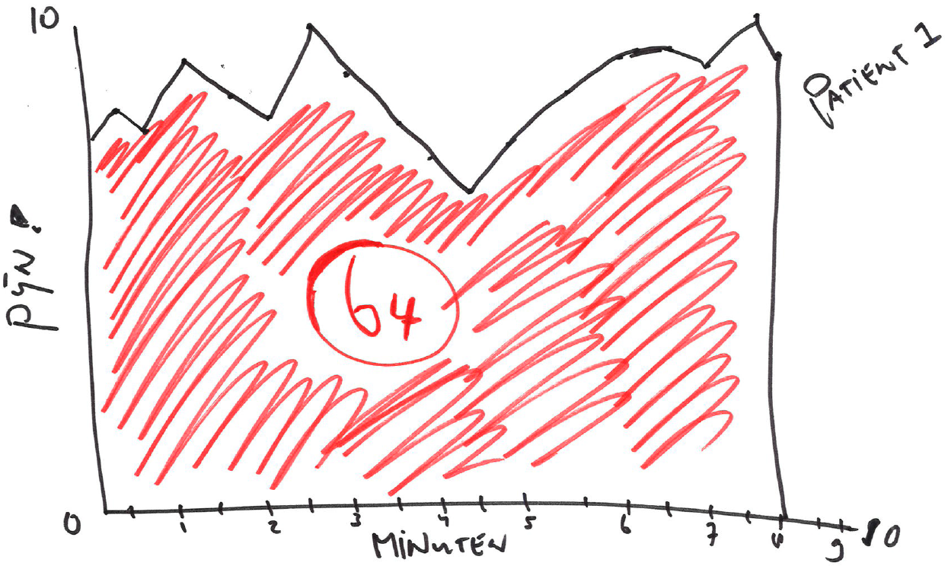
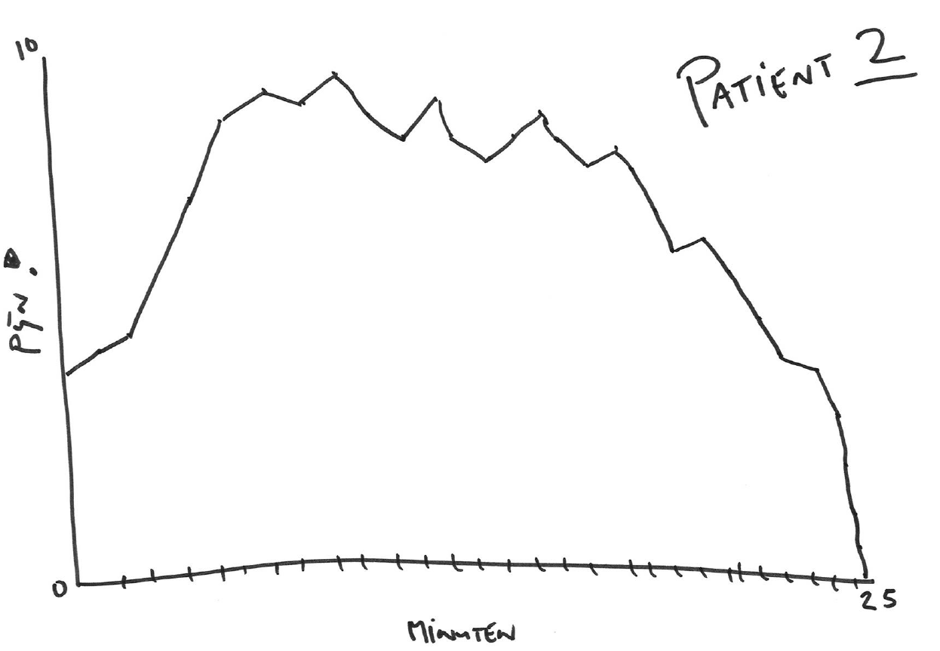

Slide 21
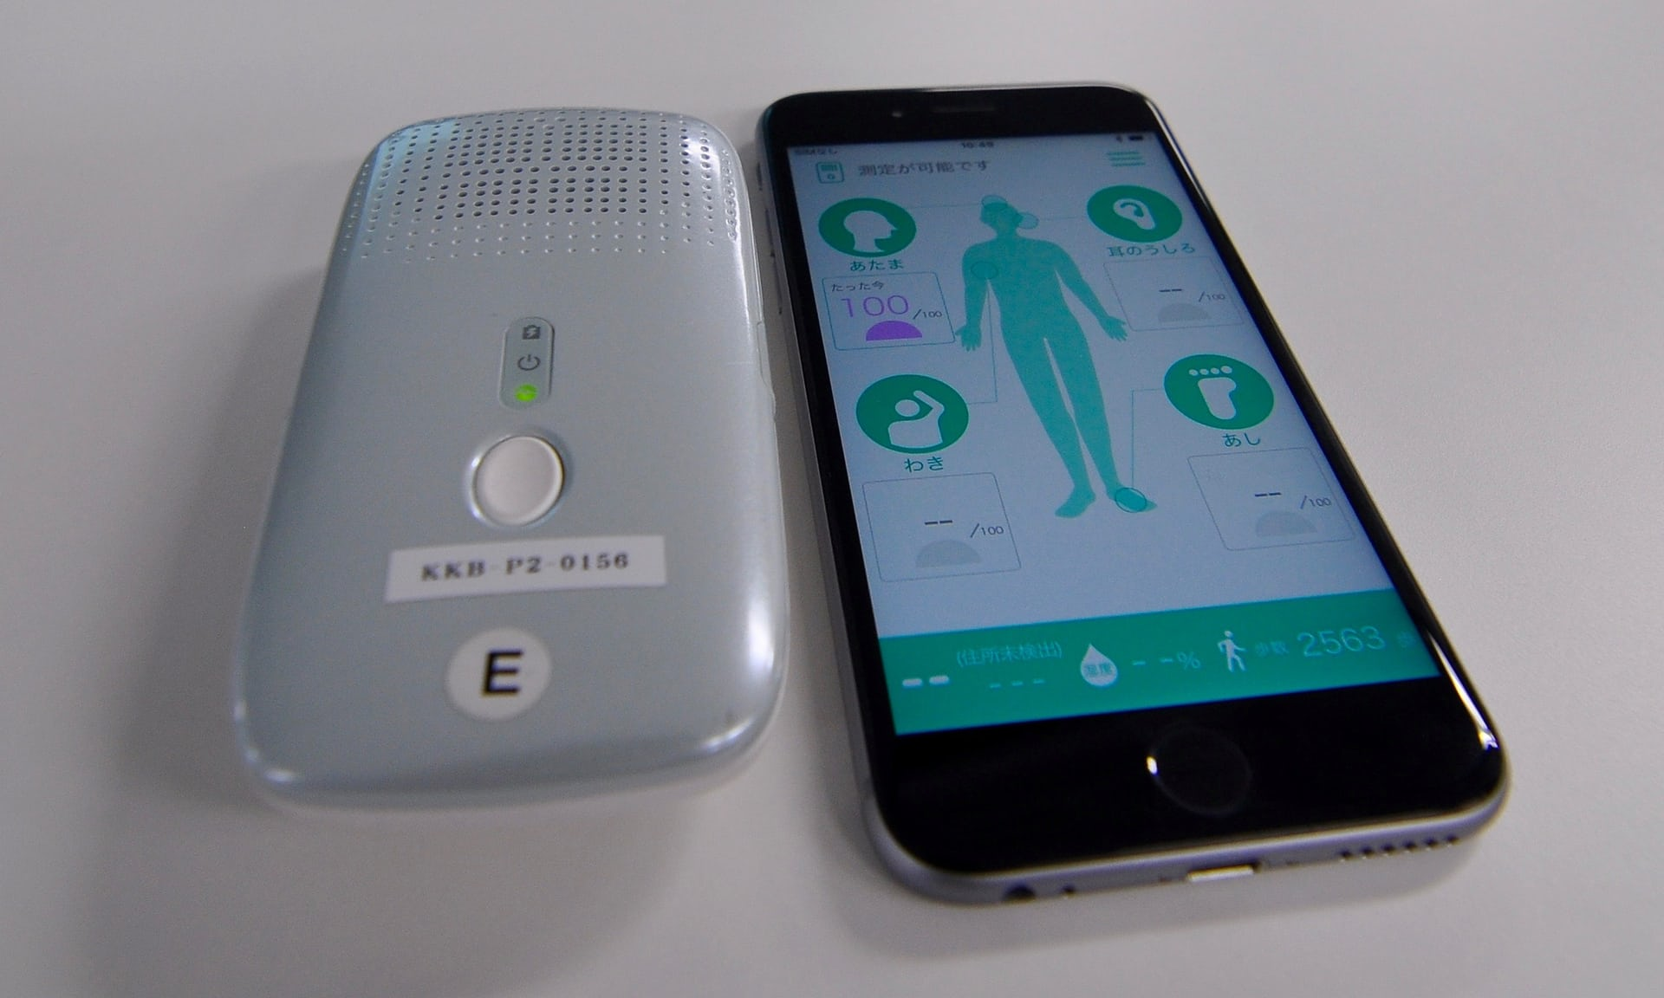

Slide 22
M

Slide 24
WWW.TICT.IO
OFFERS YOU:
A TOOL TO IMPROVE YOUR TECHNOLOGY;
A TOOL TO CRITICALLY ANALYSE A TECHNOLOGY;
A METHOD (TECHNOLOGY IMPACT CYCLE) AND BEST PRACTICES;
A REPOSITORY FOR ALL KINDS OF FRAMEWORKS, OTHER TOOLS AND INSTRUMENTS;
TEN INSPIRESTING COURSES;
ADDITIONAL MATERIALS FOR THE OBSESSED;
A COMMUNITY;
EXAMPLES OF ANALYSED TECHNOLOGIES;
AND SOON BOARD GAMES
FOR FREE!

